Slide 1
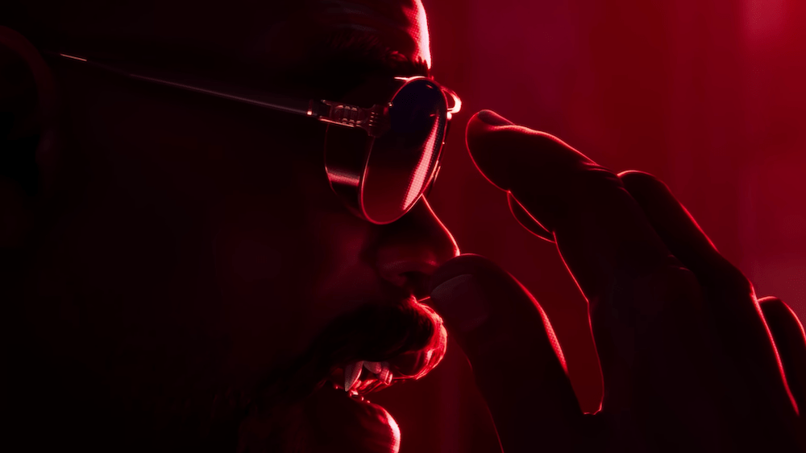
Generated Content
The Blade Staff is a summoning weapon in Terraria that allows players to summon a blade that attacks enemies. It is crafted using specific materials and is particularly useful in combat situations. The Blade Staff can be a powerful tool for players looking to enhance their gameplay experience. In this presentation, we will explore the crafting process, the abilities of the Blade Staff, and strategies for effective use in battles.

